Slide 1
ArtMove
Muhammed Çavuşoğlu
Bora Bardük
Ekin Uyumaz
Mert İnan
Duygu Durmuş

Slide 2
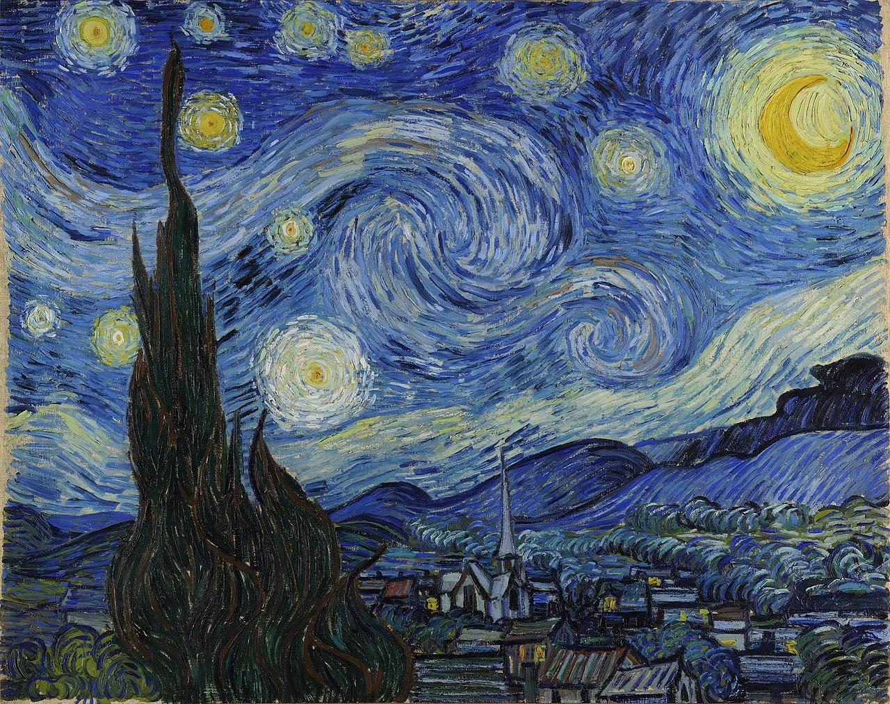
Scope of This Presentation
Description of Project
Detailed Description of Dataset
Description of Approach
Work Done & Preliminary Results
Future Objectives
Challenges and Solutions

Slide 3

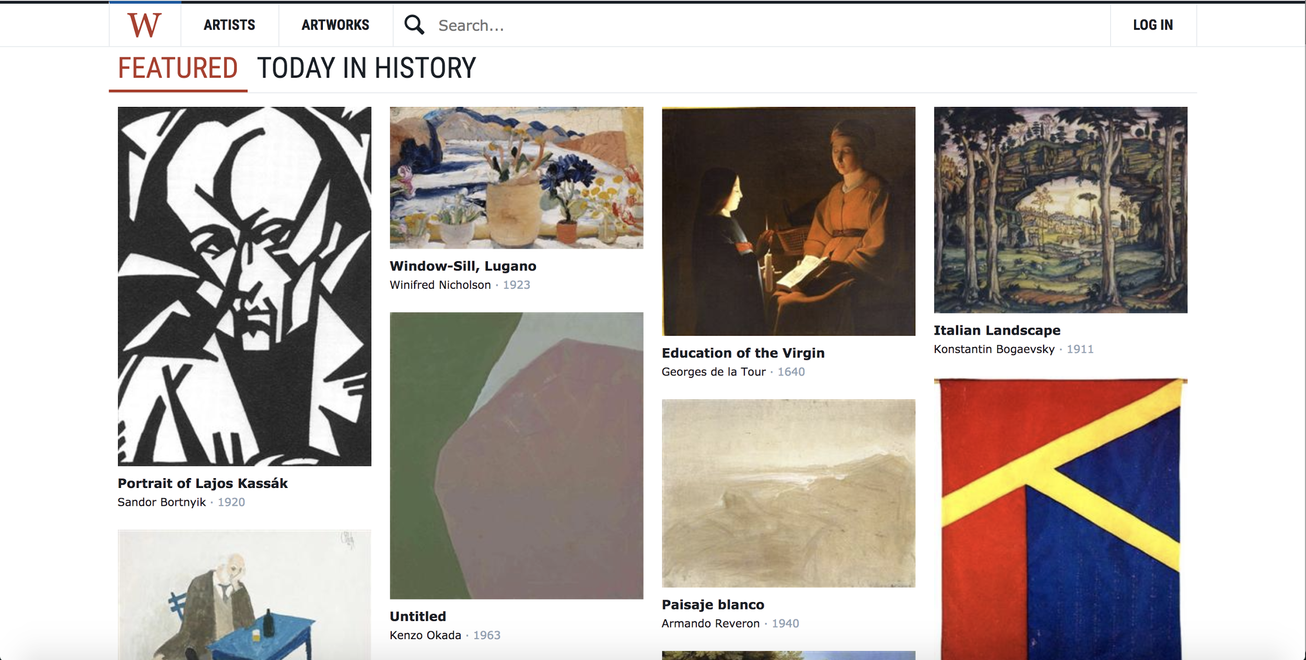
Brief Summary
Used WikiArt paintings to guess art movements
Feature extraction
with HOG (Histogram of Oriented Gradients) features
with LBP (Local Binary Patterns) features
with color tones
Algorithm comparison
using CNN ( Convolutional Neural Networks)
using kNN (k-Nearest Neighbors)
using LSTM (Long-Short Term Memory)

Slide 4
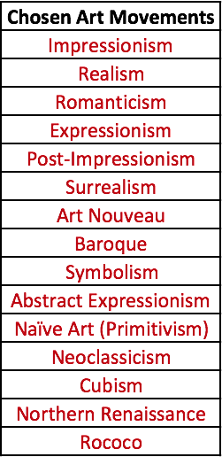
WikiArt Dataset
From 149 art movements that were in the WikiArt database, 15 were chosen.
Most art movements did not have enough images for a quality machine learning system.

Slide 5
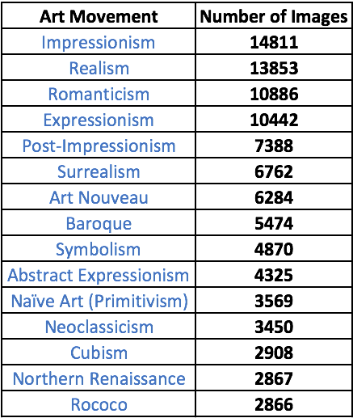
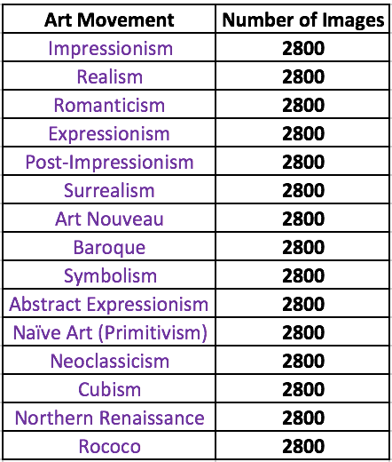
WikiArt Dataset
During the project, the number of images in the selected art movements were thresholded above 2800 samples.
For preliminary results, unbalanced 5000 images from chosen art movements are evaluated.

Slide 6
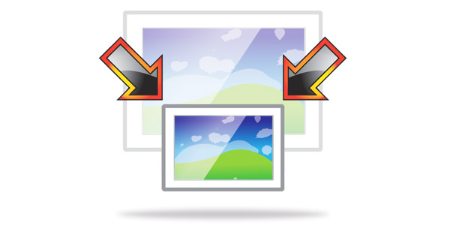
WikiArt Dataset
All images were resized to 100 x 100 pixels in order to reduce runtime since kNN was affected by the curse of dimensionality.

Slide 7

Approach
Comparison of Three Classification Models:
kNN
Model-building (k-Selection)
Cluster building (k-Means)
Convolutional Neural Networks
Model-building (Layer and Neural Network Selection)
Long Short-Term Memory
Model-building
Comparison is based on loss functions and accuracy

Slide 8
Outline of Work Done
Downloading images from Wikiart
HOG (Histogram of Oriented Gradients) Feature Extraction
Elimination of unused art movements
Matching art movements with images
Deciding on HOG feature size
Resizing the images
K-Means clustering
k-NN Model-building & Preliminary Results
Making progress on CNN algorithm

Slide 9
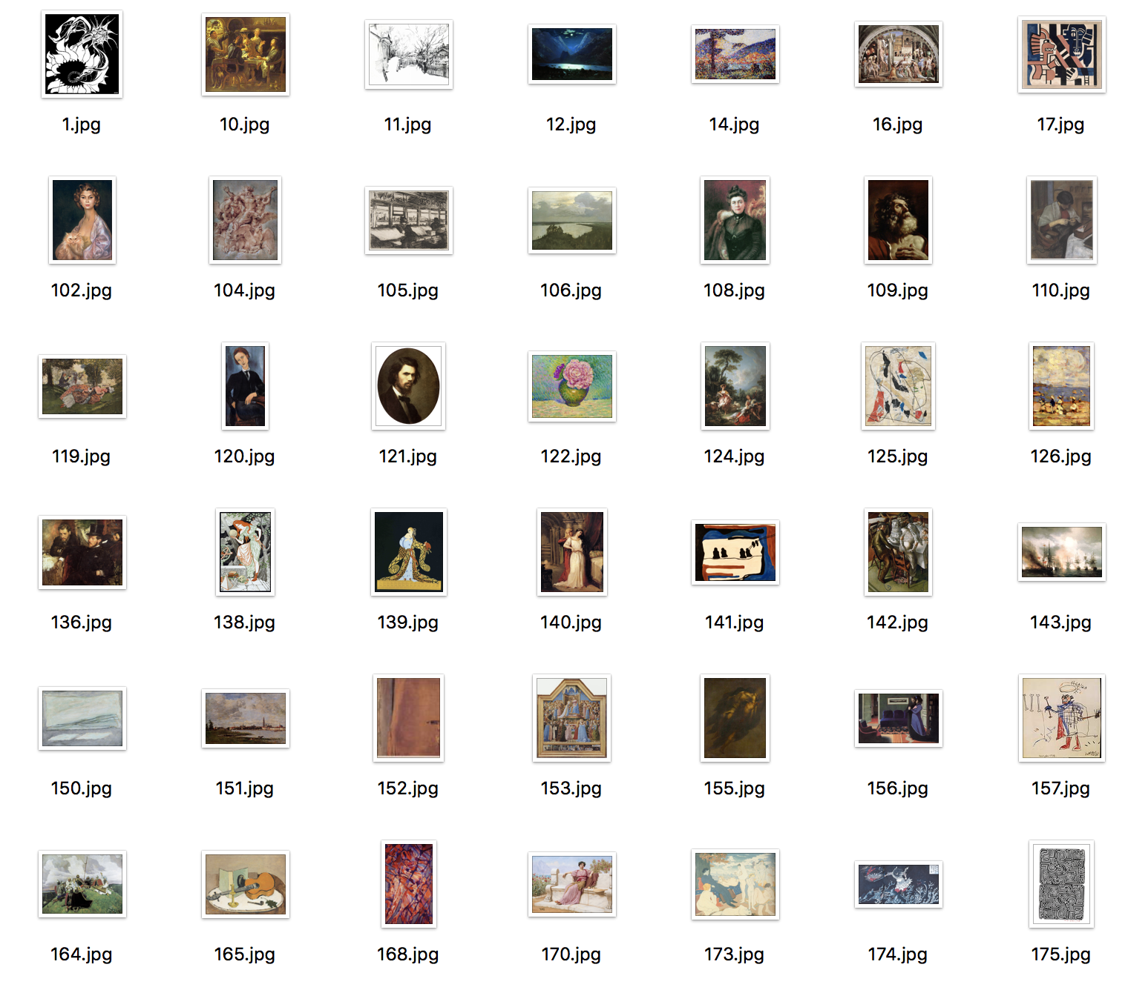
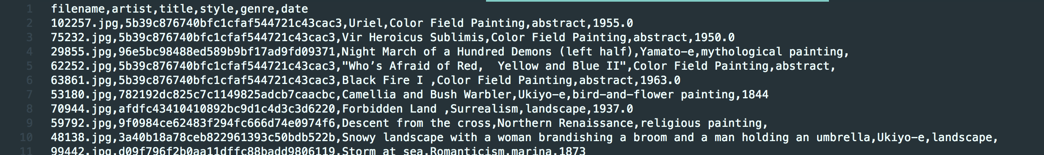
Obtaining WikiArt Data
Obtained from Kaggle.
https://www.kaggle.com/c/painter-by-numbers
Contains partitioned train data (4 GB each)
First train data partition is used for preliminary tests
Not-indexed
Not-preprocessed
Unbalanced
Only first 5000 images were used for preliminary results.
Includes a separate csv file containing metadata of the paintings, which needed to be sorted and matched with images

Slide 10
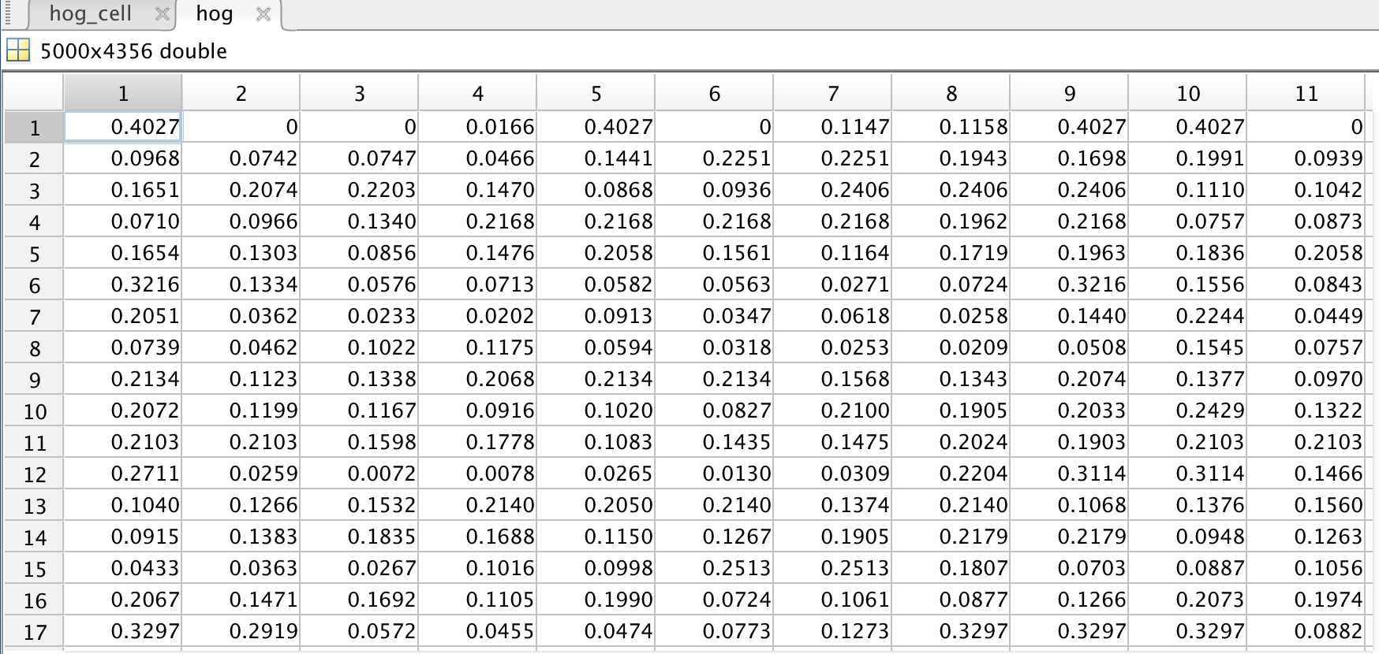
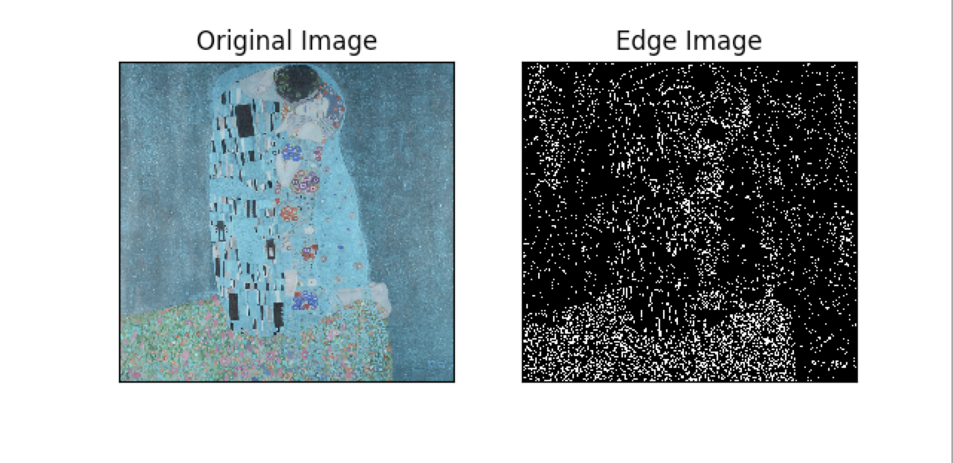
2. HOG Feature Extraction
First Canny Edge Detection was used
Then decided on HOG feature extraction
ExtractHOGFeatures function of MATLAB is used to extract features directly from the images.

Slide 11
3. Elimination of Unused Art Movements
15 art movements mentioned earlier were used.
Unused art movements and paintings were removed from the initial training dataset.
Initial training data contained 5000 original images which was reduced to 3492 after elimination.
This is prone to unbalanced partioning. For the whole data, precautions will be taken.

Slide 12
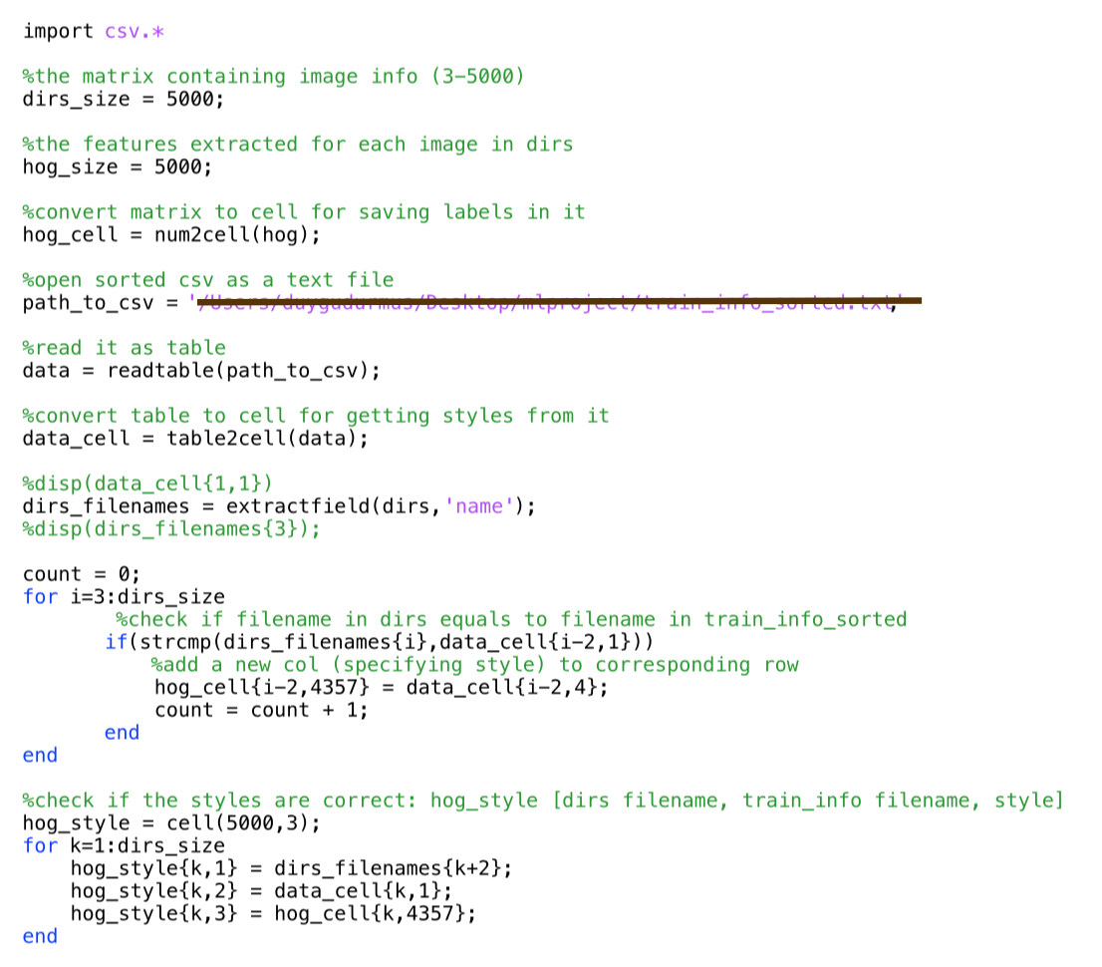
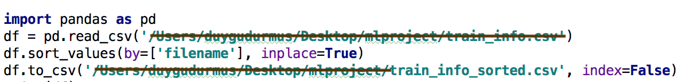
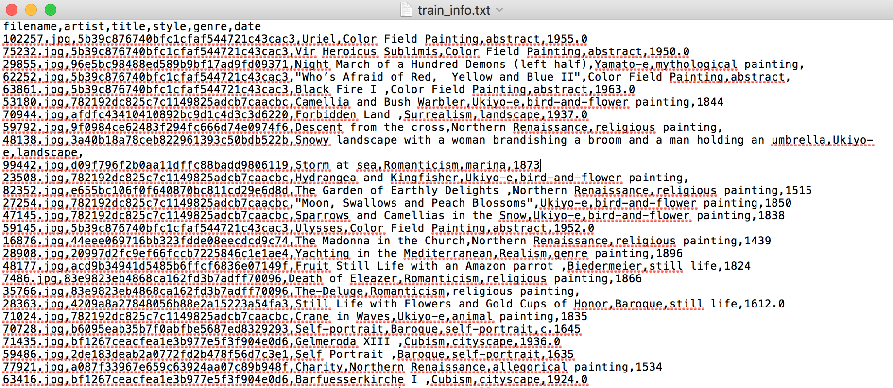
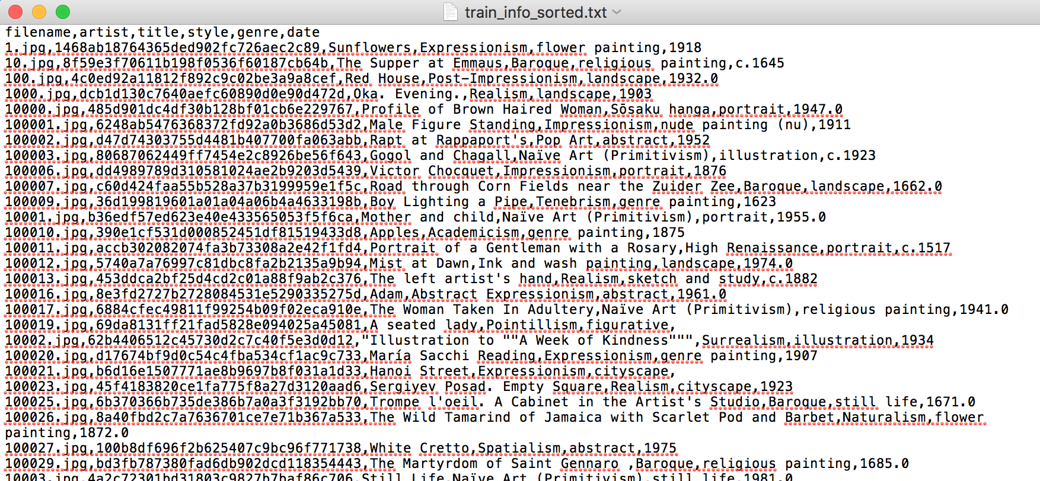
4. Matching Art Movements with Images
Sorted train data based on filename
Matched art movements with each image (in total 5000 images for preliminary results)

Slide 13
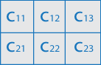
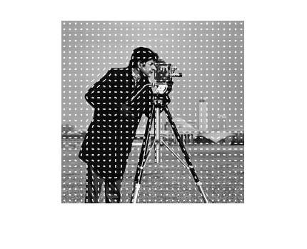
5. Deciding on HOG Feature Size
HOG features depend on the size of the image.
300 x 300 yields 46526 features
100 x 100 yields 4356 features
The latter is chosen for runtime and dimensionality efficiency.

Slide 14
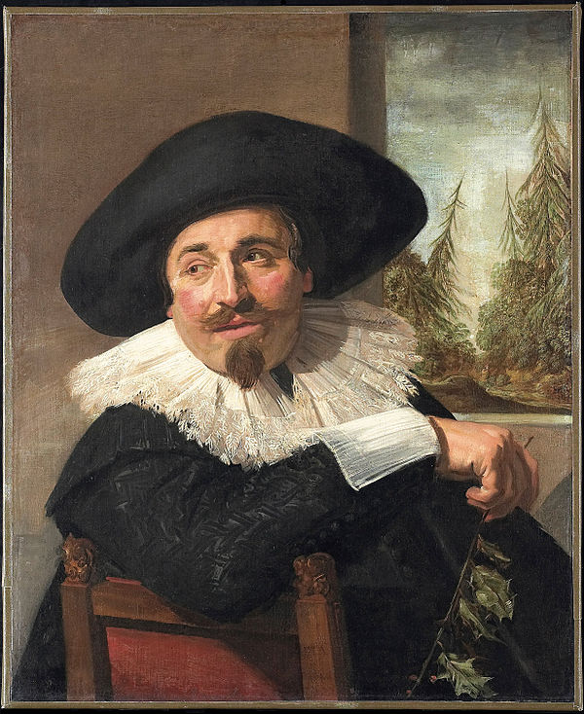
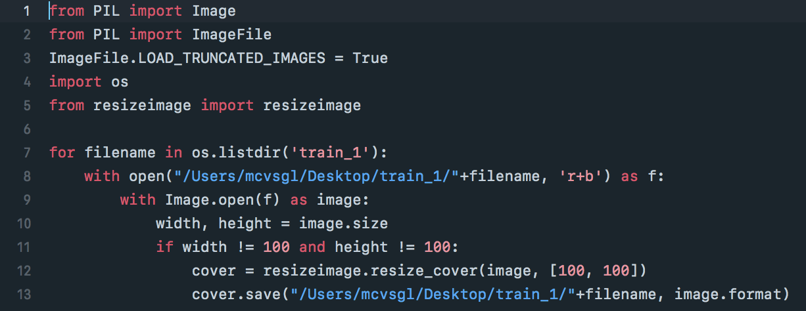
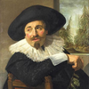

6. Resizing the images
Using Python Imaging Library (PIL), we resized the images to 100 x 100.
Data size was reduced from 5 GB to 40 MB.

Slide 15
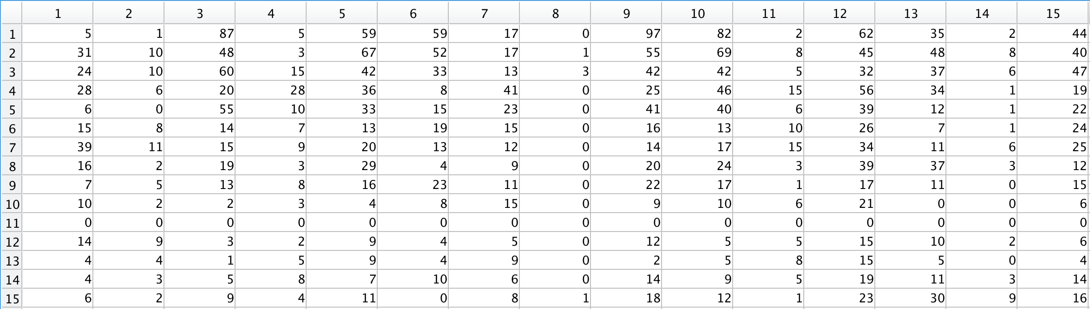
7. K-means Clustering
kmeans function of MATLAB is used to cluster data.
k value is chosen to be 15, which is the same as art movement count
To see an intrinsic clustering of data without any classification algorithms
Clusters
Art Movements

Slide 16
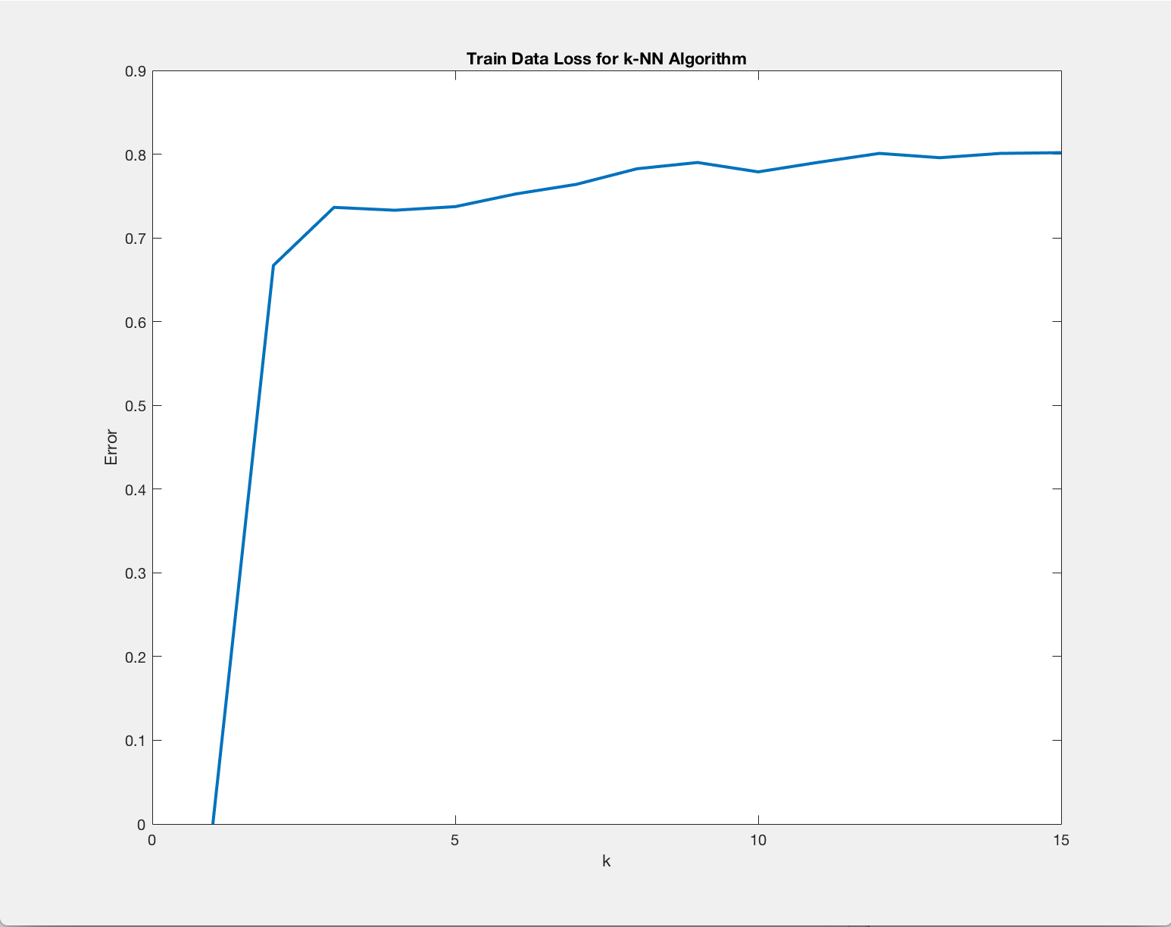
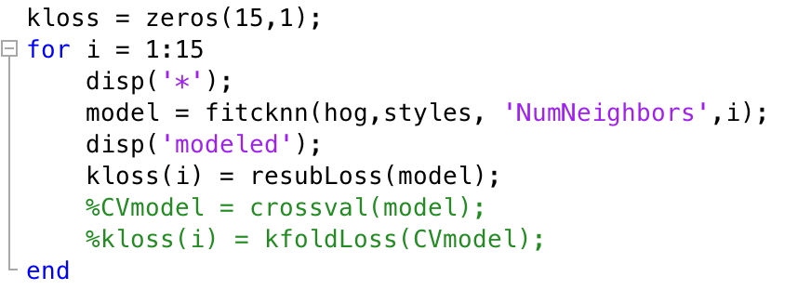
8. k-NN Model Building & Preliminary Results
ClassificationKNN library of MATLAB is used.
fitcknn function is used.
First 5000 data were used and training error is calculated with resubloss function.
Error is high (0.65 >) so most probably k-NN will be the least accurate model on the dataset.

Slide 17

9. Making Progress on CNN Modelling
Conducted research to further understand the nature of Convolutional Neural Networks.
Started implementation of CNN Model using Tensorflow
Understanding data types associated with Tensorflow API
Started implementation using Python

Slide 18
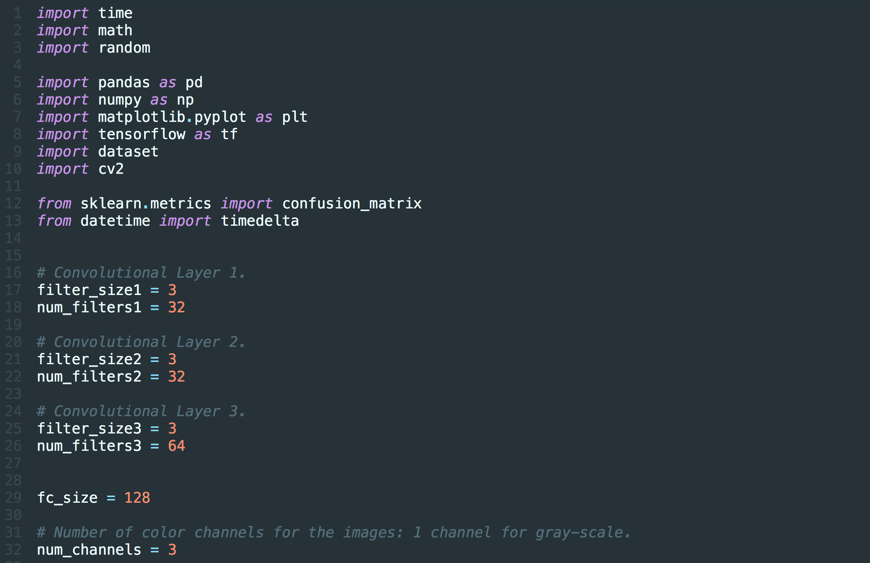
9. Making Progress on CNN Modelling

Slide 19
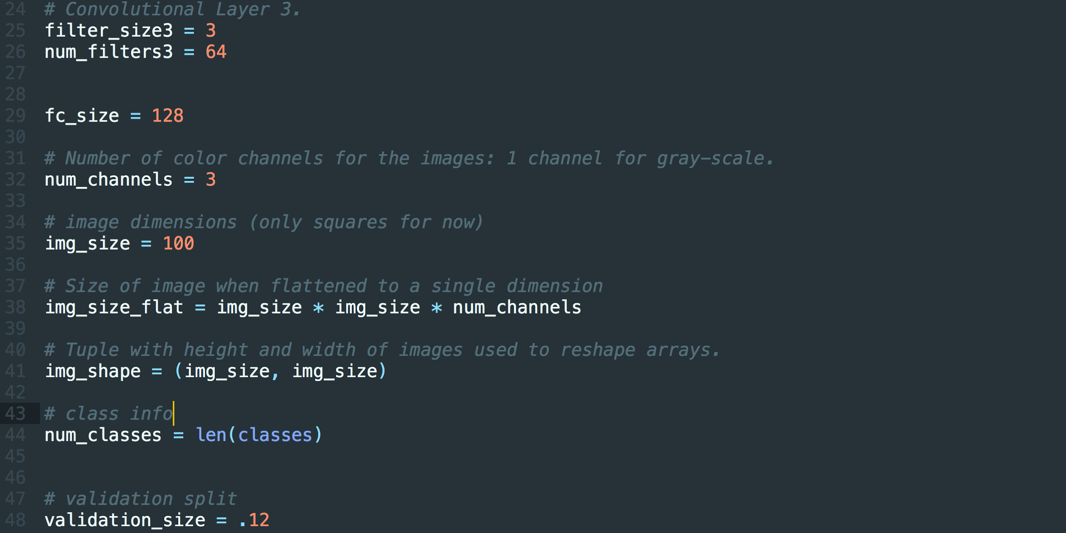
9. Making Progress on CNN Modelling

Slide 20
Discussion of Challenges and Solutions
Unaccustomed Technologies - Research
Obtaining and Preprocessing Data - Developed Algorithms
CNN Data Compatibility - Observed Example Projects
Cross-Validation Long Runtime - Decreasing Dataset Size or Other Solutions

Slide 21
THANK YOU FOR YOUR ATTENTION

